Slide 1

Department of Information Technology
NBA Accredited A.P. Shah Institute of Technology G.B.Road,Kasarvadavli, Thane(W), Mumbai-400615 UNIVERSITY OF MUMBAI Academic Year 2021-2022

Slide 2
A Project Report on Spaced Repetition Based Adaptive E-Learning
Framework Submitted in partial fulfilment of the degree of
Bachelor of Engineering(Sem-8) in INFORMATION TECHNOLOGY By Neelay Umrotkar (16104041) Varun Godambe (17104040) Amit Kharwal (17104045) Under the Guidance of Dr. Uttam Kolekar
Prof. Vishal Badgujar

Slide 3
1.Project Conception and Initiation

Slide 4
1.1 Abstract
With global education moving towards online education, we see a lot of emerging techniques to help facilitate paradigm shift. Memorization being a fundamental part of the process of learning, we focus on making memorizing an efficient task for students. We plan to make use of 2 emerging methodologies (Spaced Repetition and Adaptive Learning) that help us memorize and retain in-formation better in the long term.
To help users stay consistent, we plan to add game-like elements to the system to help facilitate regular use which will lead to better results.

Slide 5
1.2 Objectives
To design an adaptive algorithm that takes user performance into account in order to adapt the next question's levels.
To design a space repetition algorithm that takes user's specific quiz performance into account.
To integrate Adaptive and Spaced repetition algorithms for the proposed system.
To add game design elements to make the layout appealing.
To create a cross-platform application interface.

Slide 6
1.3 Literature Review
Sr. No. | Author | Conference | Paper Name | Learnings
1 | Rajesh C. Panicker, Akash Kumar, Deepu John, Dipti Srinivasan | 2018 IEEE International Conference on Teaching, Assessment, and Learning for Engineering | Adaptive Learning and Analytics in Engineering Education. | Asking students questions from a certain topic based on their mastery of said topic. Segregation of quiz questions into levels ranging from very easy to extremely difficult to challenge students of all levels and at the same time cater to their mastery levels.

Slide 7
1.3 Literature Review
Sr. No. | Author | Conference | Paper Name | Learnings
2 | Martin K.-C. Yeh, Abtin Toshtzar, Laura Guertin, and Yu Yan | 2016 IEEE Frontiers in Education Conference | Using Spaced Repetition and Gamification to Enhance K-12 Student Science Literacy With On-Demand Mobile Short Reads. | Game like elements result in more students actively learning. Spaced repetition keeps them engaged with the help of “acquisition cards” and “Maintenance Cards.”

Slide 8
1.3 Literature Review
Sr. No. | Author | Conference | Paper Name | Learnings
3 | Bingxue Zhang, Yuxiang LI, Yang SHI, Longfeng | 2020 IEEE 20th International Conference on Advanced Learning Technologies (ICALT) | Recognition and Application of Learner’s Cognitive Ability for Adaptive E-learning. | Game like elements result in more students actively learning. Spaced repetition keeps them engaged with the help of “acquisition cards” and “Maintenance Cards.”

Slide 9
1.3 Literature Review
Sr. No. | Existing Architecture | Learnings
4 | Anki App | Design of the app is key. Flashcards are a solid medium for quizzing SP Algorithms are extremely effective at tasks involving memorization.
5 | Clozemaster | User retention is directly linked to app design Game-like elements help keep the user engaged and compete with others leading to good academic habits

Slide 10
1.4 Problem Definition
Problem Identified: Learning, a lot of the times, is based on memorization. This can be especially difficult for people to achieve easily and leads to cramming and other ineffective short-term methods which can damage the learning process and are generally ineffective.

Slide 11
1.5 Scope
Can be used by individual users for personal use.
Can be adopted by schools and universities to develop custom material.
Individual user analysis can be provided to let the person-in-charge better understand the needs of their target audience.
Can make the process of memorization passive and learning efficient globally.

Slide 12
1.6 Technology stack
Flutter - For cross platforming.
JSON - For question repository.
Java – Algorithm implementation.
Dart - For UI Structuring and Flutter compatibility.
Firebase - For Login/Signup Authentication.

Slide 13
1.7 Benefits for environment & Society
Makes memorization a passive skill.
Makes memorization efficient and effortless.
Allows students to focus on learning.
Tremendous scalability right from smaller classes to university.

Slide 14
2. Project Design

Slide 15
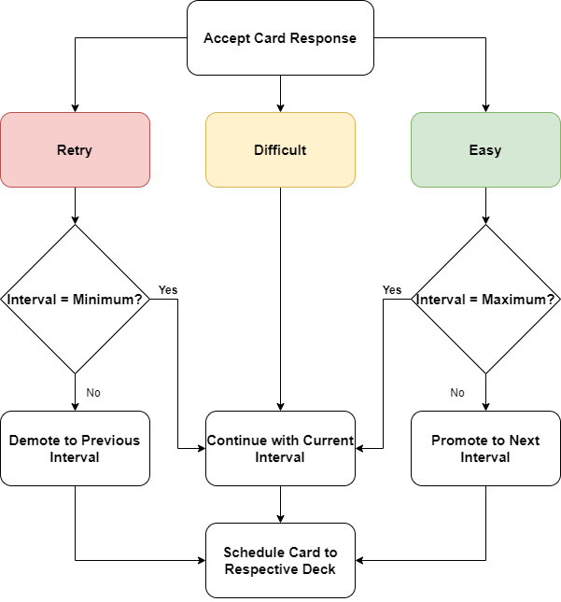
2.1 Proposed System: Spaced Repetition
Interval Progression:
18 Minutes
1 Day
6 Days
30 Days
3 Months
6 Months
2.1 Spaced Repetition Architecture

Slide 16
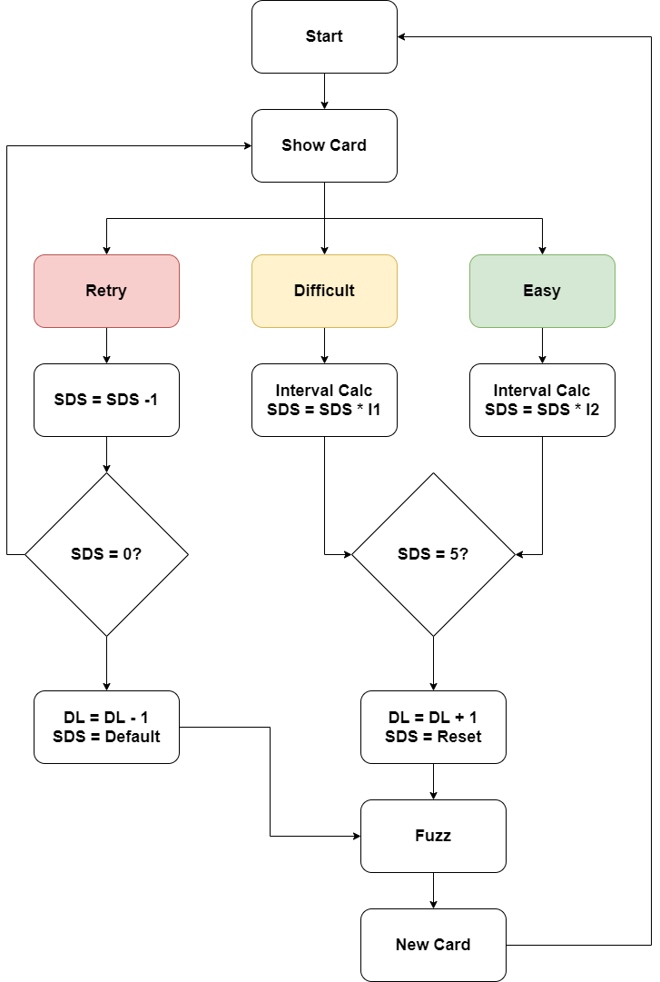
2.1.2 Proposed System: Adaptive Learning
Legend:
SDS: Same Difficulty Score
DL: Difficulty Level
Fuzz: Randomness
2.1.2 Adaptive Learning Architecture

Slide 17
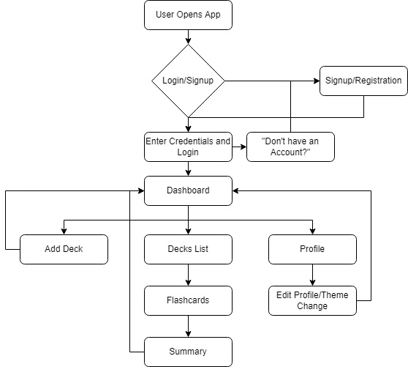
2.2 Design(Flow Of Modules)
2.2 Flow Diagram

Slide 18
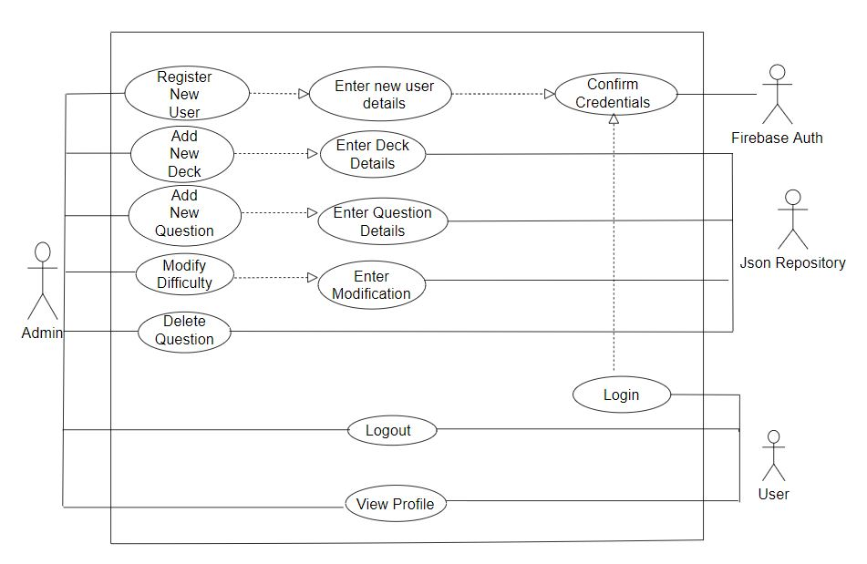
2.3 Use Case for Swipes App
2.3 Adaptive Learning Architecture

Slide 19
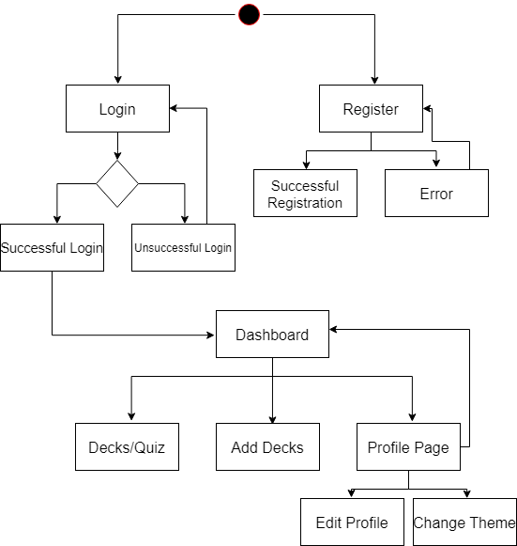
2.4 Activity diagram
2.4 Adaptive Learning Architecture

Slide 20
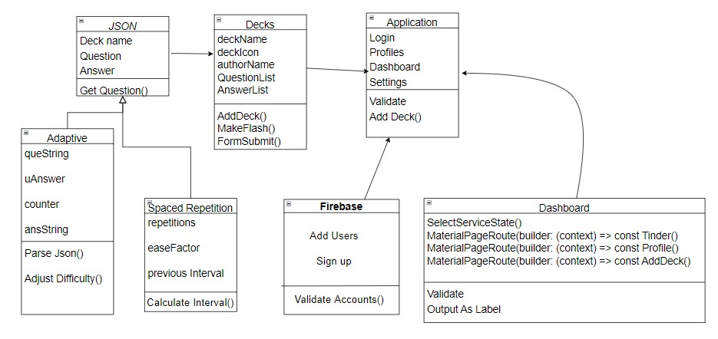
2.5 Class Diagram
2.5 Adaptive Learning Architecture

Slide 21
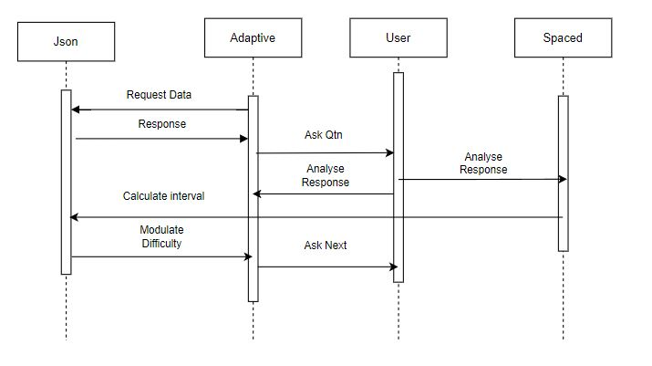
2.6 Sequence Diagram: Swipes App
2.6 Adaptive Learning Architecture

Slide 22
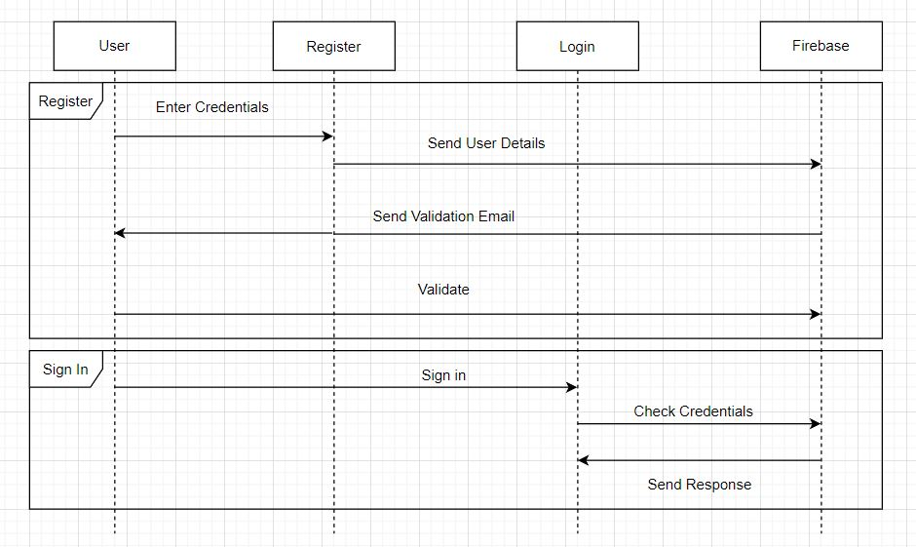
2.6.2 Sequence Diagram: Authentication
2.6.2 Adaptive Learning Architecture

Slide 23
3. Implementation

Slide 24
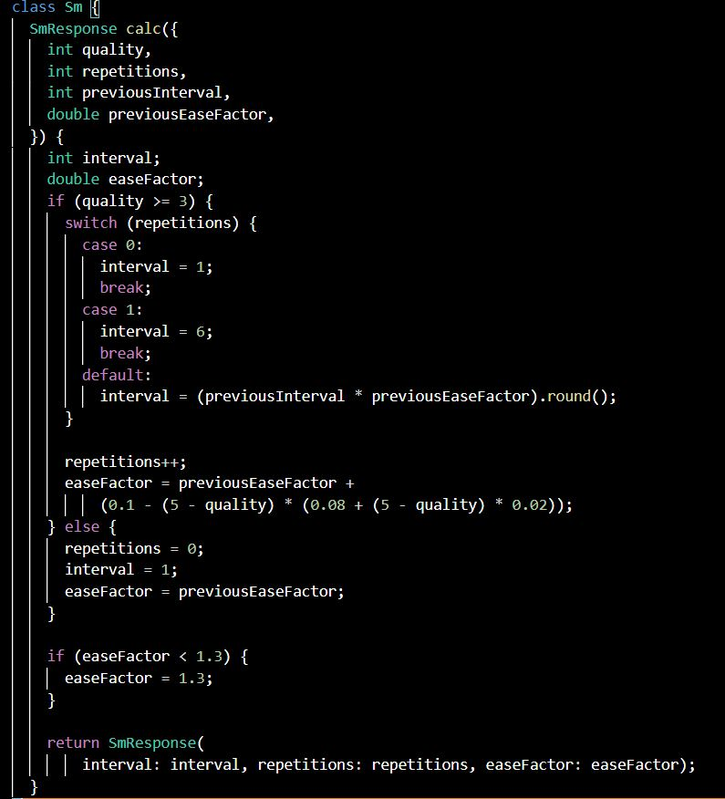
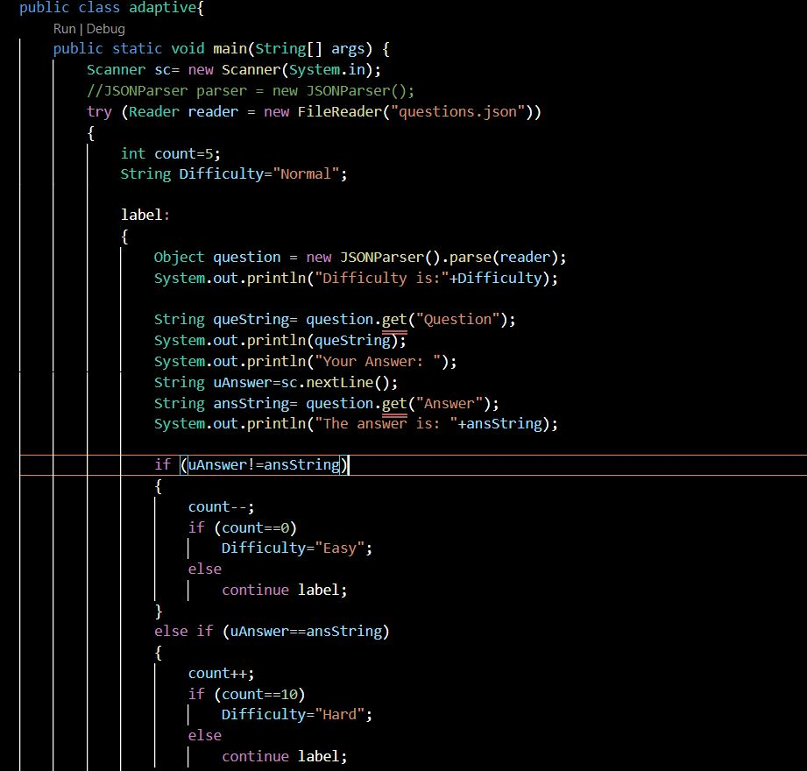
Spaced Repetition
Adaptive Algorithm

Slide 25
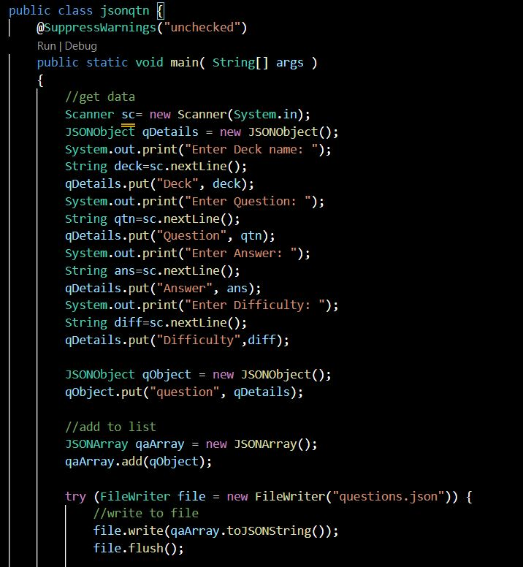
JSON - Adding Question

Slide 26
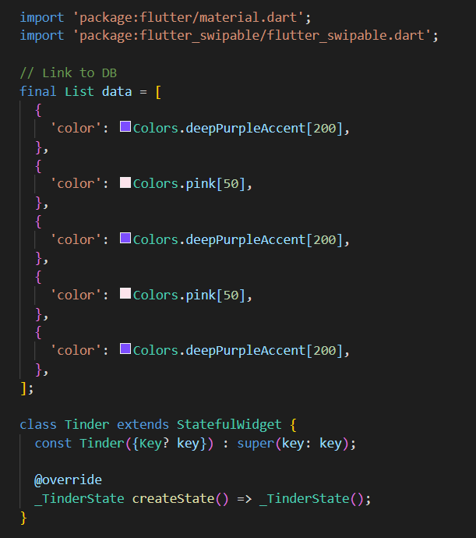
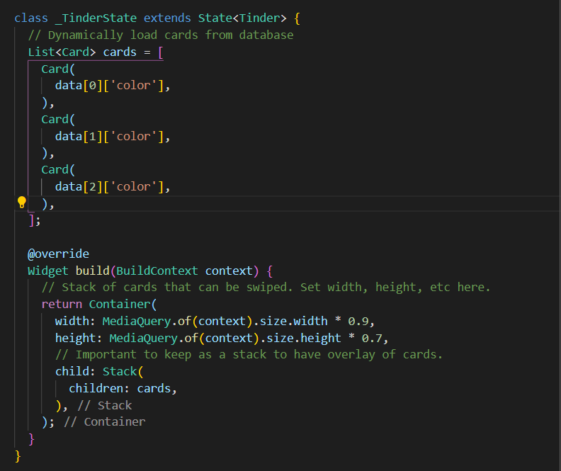
Flashcard Initialization and Behaviour

Slide 27
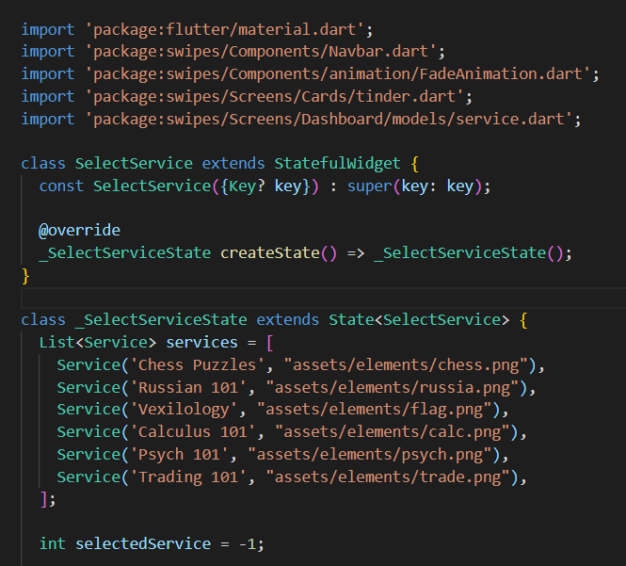
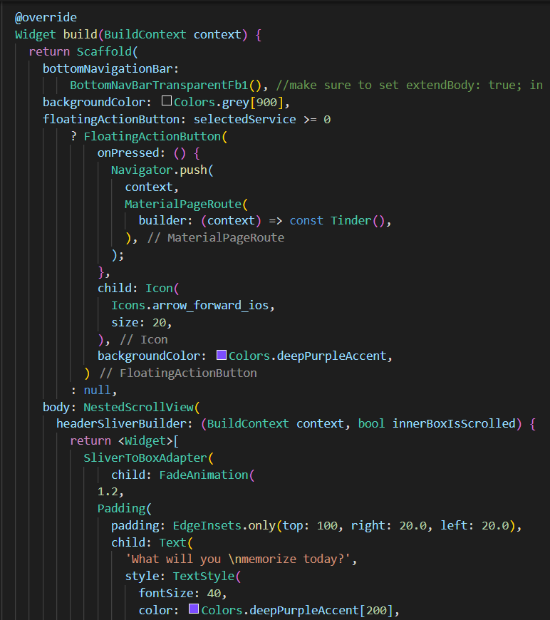
Dashboard UI

Slide 28
4. Testing

Slide 29
Functional Testing:
Identification of functional needs:
Infallible Spaced Repetition algorithm performance.
Infallible Adaptive Learning algorithm performance.
Login/Signup Authentication for security.
Profile editing function.

Slide 30
Non-Functional Testing:
Identification of non-functional needs:
Consistent design.
Attractive visuals.
Faster loading times.

Slide 31
5. Result

Slide 32
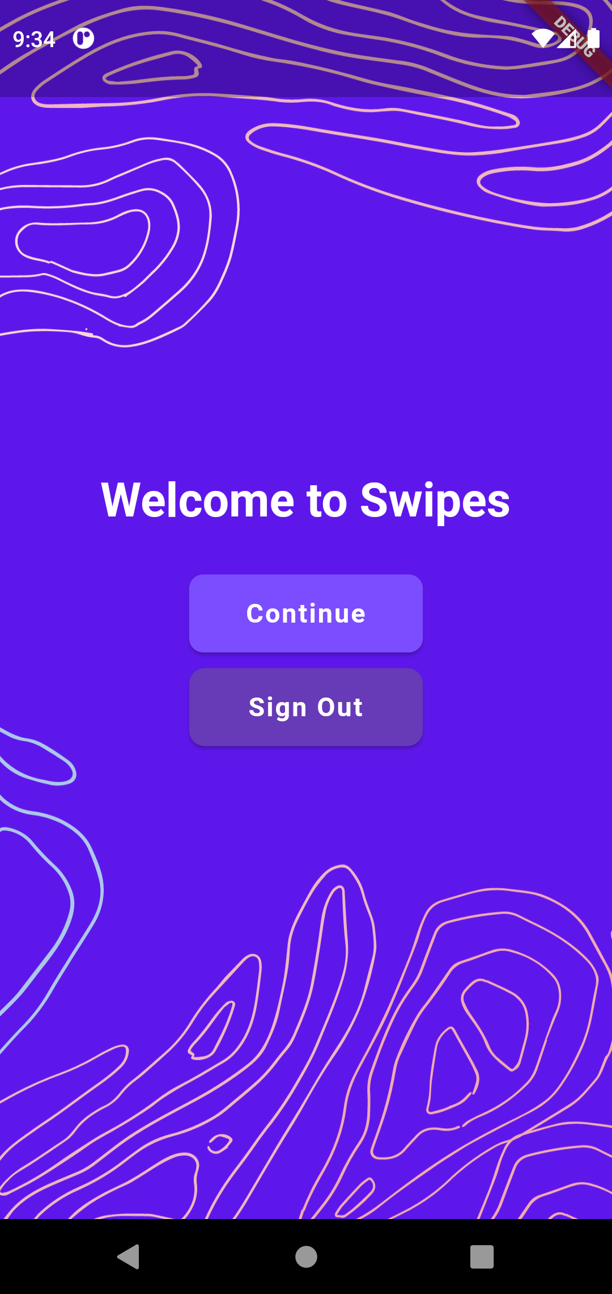
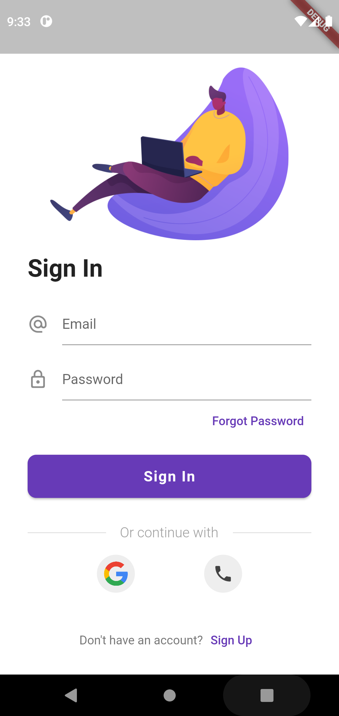
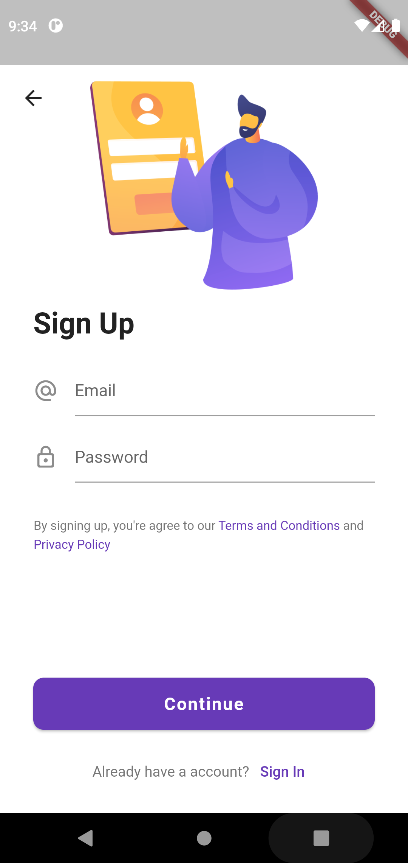
Landing Screen
Login Screen
Signup Screen

Slide 33
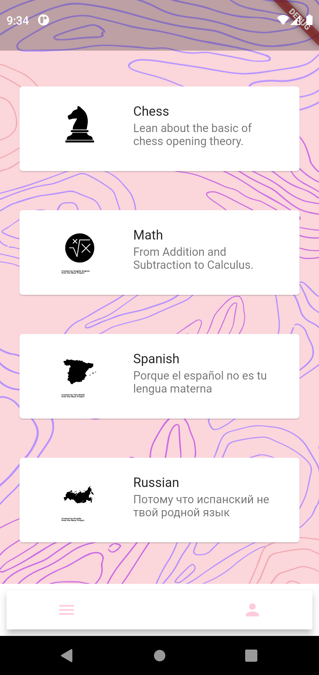
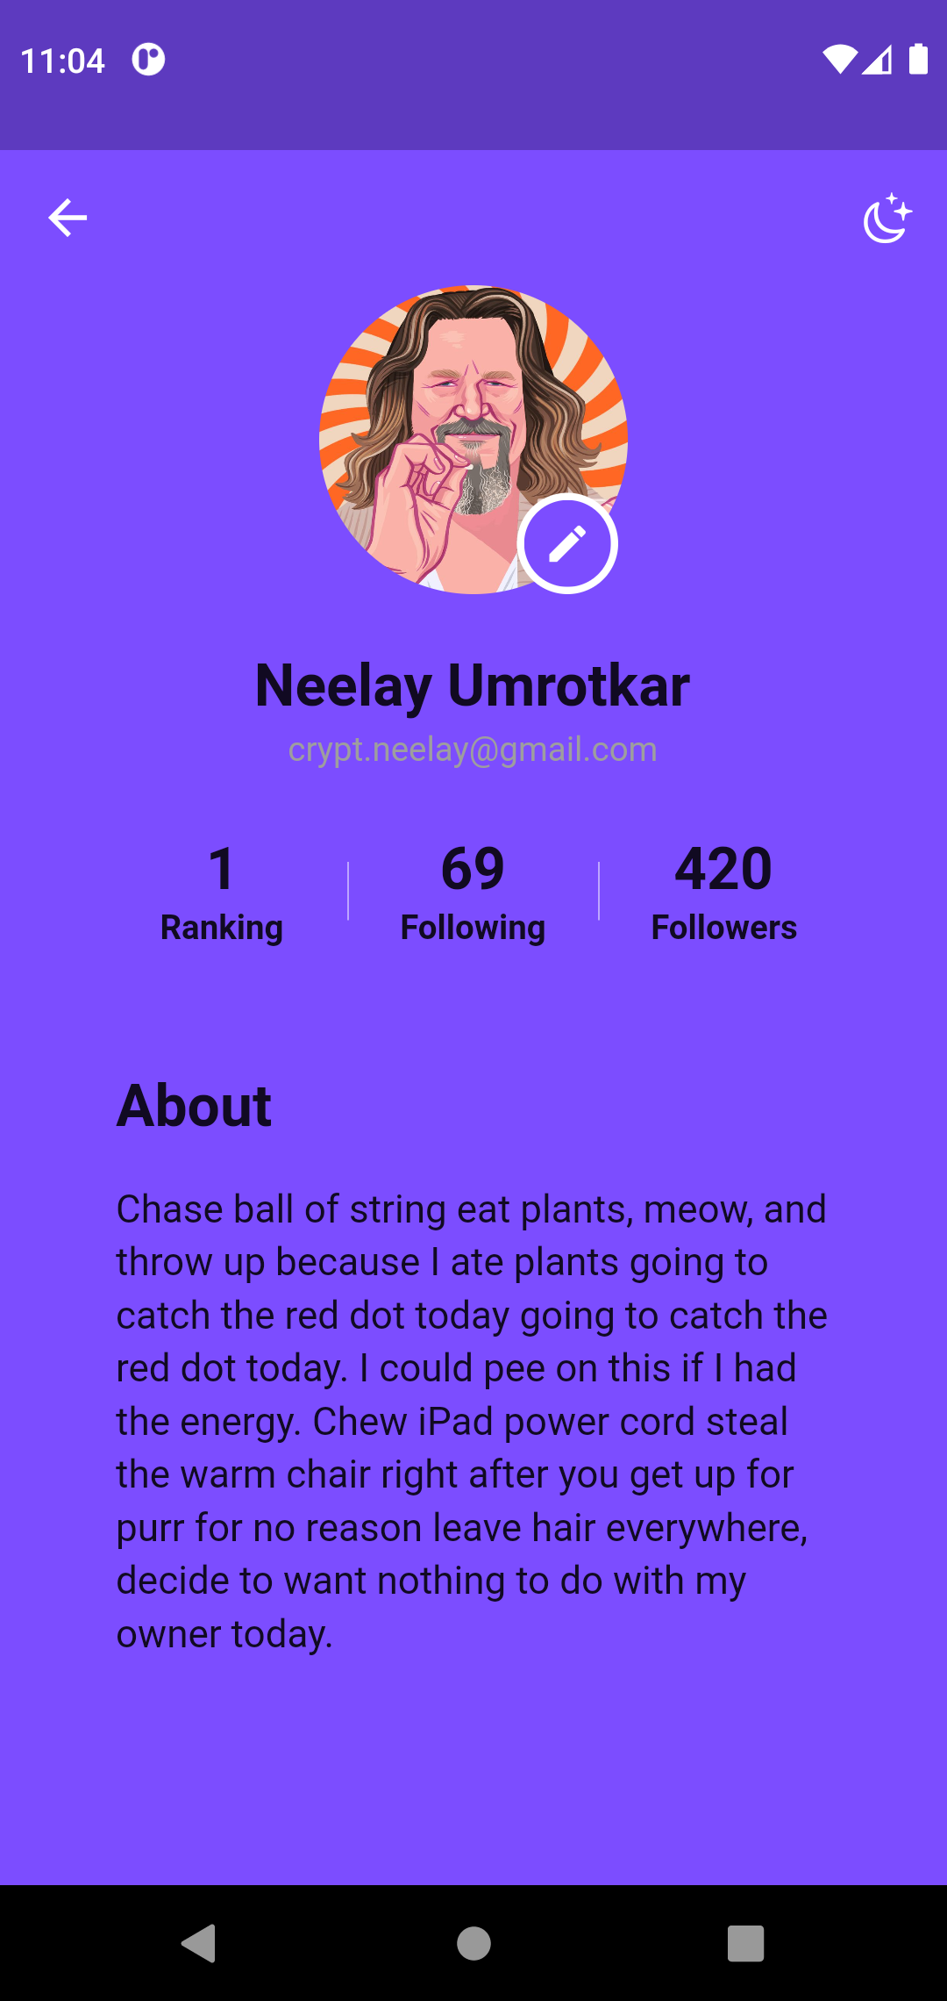
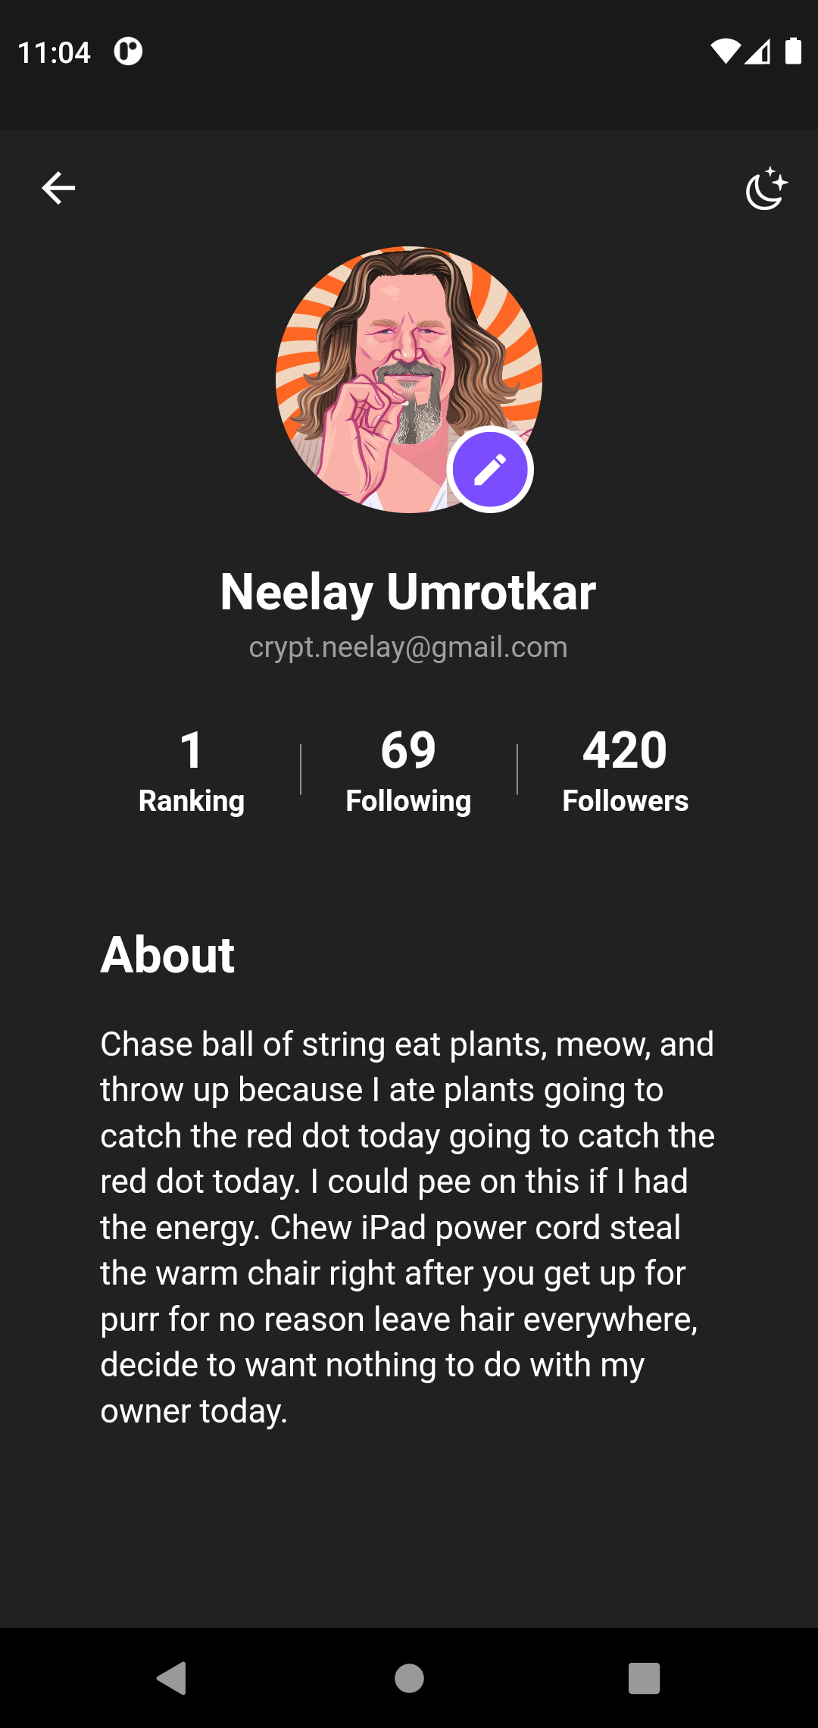
Dashboard
Profile – Light Mode
Profile – Dark Mode

Slide 34
6. Conclusion and Future Scope

Slide 35
Conclusion
To summarize, we propose a new system that aids in memorization, of which the 3 core components are Spaced Repetition, Adaptive Learning and Game-Like Elements.
With the use of our adaptive learning algorithm and spaced repetition algorithm, we have made the process of learning passive.
The system helps students to not only memorize but also adapts itself to the needs of the students just as a personal tutor would.
The design of the app helps keep users engaged and maximises user retention.

Slide 36
1.5 Future Scope
Can be used by individual users for personal use.
Can be adopted by schools and universities to develop custom material.
Individual user analysis can be provided to let the person-in-charge better understand the needs of their target audience.
Can make the process of memorization passive and learning efficient globally.

Slide 37
References
[1] Supermemo Algorithm. Accessed August 2021. url: https://www.supermemo.
com/en/archives1990-2015/english/ol/sm2.
[2] Anki. Frequently Asked Questions. Accessed August 2021. url: https:
//faqs.ankiweb.net/what-spaced-repetition-algorithm.html.
[3] Clozemaster. Frequently Asked Questions. Accessed August 2021. url:
https://www.clozemaster.com/faq.
[4] Shetu S. F. et al. Impactful e-learning framework: A new hybrid form
of education. 2021. url: https://www.sciencedirect.com/science/
article/pii/S2666518221000255.
[5] MAH Masud and X Huang. An e-learning system architecture based on
cloud computing. 2021. url: https://citeseerx.ist.psu.edu/viewdoc/
download?doi=10.1.1.221.4704&rep=rep1&type=pdf.

Slide 38
References
[6] Rajesh C. Panicker et al. Adaptive Learning and Analytics in Engineering
Education. 2018.
[7] Hongchao Peng, Shanshan Ma, and Jonathan Michael Spector. Person-
alized adaptive learning: an emerging pedagogical approach enabled by a
smart learning environment. 2019.
[8] Florian Schimanke et al. Implications of Short-Term Memory Research for
the Design of Spaced Repetition Based Mobile Learning Games. 2015.
[9] Burr Settles and Brendan Meeder. A Trainable Spaced Repetition Model
for Language Learning. 2016.
[10] J. Whittman. The Forgetting Curve. url: https://www.csustan.edu/
sites/default/files/groups/Writing%20Program/forgetting_curve.
pdf.

Slide 39
References
[11] Martin K.-C. Yeh et al. Using Spaced Repetition and Gamication to En-
hance K-12 Student Science Literacy with On-Demand Mobile Short Reads.
2016.
[12] Bingxue ZHANG et al. Recognition and Application of Learner's Cognitive
Ability for Adaptive E-learning. 2020.
[13] How to Remember More of What You Learn with Spaced Repetition: https://collegeinfogeek.com/spaced-repetition-memory-technique/
[14] Ebbinghaus; Forgetting Curve: https://www.psychestudy.com/cognitive/memory/ebbinghaus-forgetting-curve
[15] App Design Best Practices: https://xd.adobe.com/ideas/principles/app-design/#:~:text=What%20Is%20App%20Design%3F,the%20actual%20functionality%20and%20usability.

Slide 40
References
[16] Essential Patterns of Mobile Navigation: https://xd.adobe.com/ideas/principles/app-design/essential-patterns-mobile-navigation/
[17] How to Use Mental Models in UX Design: https://xd.adobe.com/ideas/process/ui-design/how-to-use-mental-models-in-ux-design/
[18] The Pimsleur Method: https://www.pimsleur.com/the-pimsleur-meth
[19] Lingvist: https://lingvist.com/about-us/
[20] An e-learning system architecture based on cloud computing
MAH Masud, X Huang - system, 2012 - researchgate.net

Slide 41
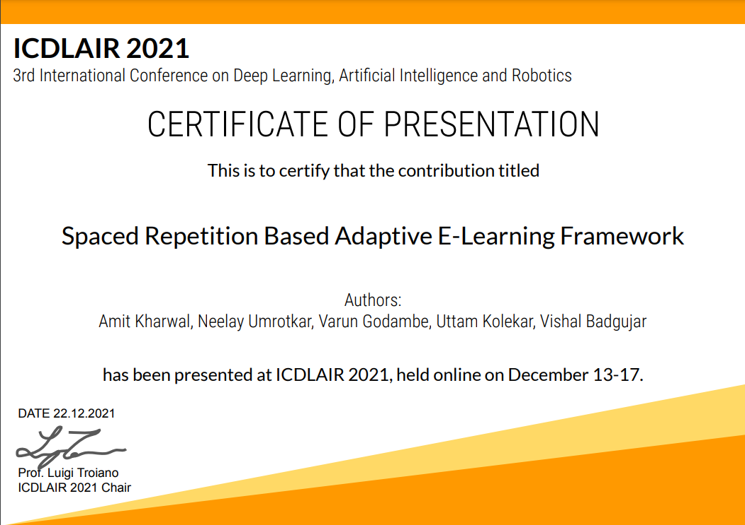
Paper Publication
Paper entitled “Spaced Repetition Based Adaptive E-Learning Framework” is presented at “3rd International Conference on Deep Learning, Artificial Intelligence and Robotics(ICDLAIR 2021)” by “Neelay Umrotkar, Varun Godambe, and Amit Kharwal”.

Slide 42
Thank You

